Slide 1


A GUIDE TO CREATING COMMUNITY CLUBS FOR SOCIAL & DIGITAL INCLUSION
www.bestieproject.eu
The European Commission support for the production of this publication does not constitute an endorsement of the contents which reflects the views only of the authors, and the Commission cannot be held responsi­ble for any use which may be made of the information contained therein 2021-1-FR01-KA220-ADU-000033505﻿
2022 – 2024
'HOW TO’ GUIDE
By
FUNDACION CIBERVOLUNTARIOS

Slide 2
contents
01
INTRODUCTION
02
FORMING A CLUB
03
RUNNING COMMUNITY CLUBS
04
DIGITAL TOOLS FOR CARRYING OUT ACTIVITIES
05
ANNEXES
CONTACT US!
CC BY
This license enables reusers to distribute, remix, adapt, and build upon the material in any medium or format, so long as attribution is given to the creator. The license allows for commercial use. CC BY includes the following elements:
BY: credit must be given to the creator.
2

Slide 3
01
INTRODUCTION

Slide 4
1.1. What is a Community Club?
This guide is developed to help you initiate a Community Club. The aim is to promote clubs that are inclusive learning and sharing spaces.
In these clubs, people from different backgrounds (older, young and migrants) will spend time together and help each other with technology with assistance from the club. We want these clubs to grow and endure over time.
Use this guide as a canvas to create Clubs based on the needs of your community.
First consider your own circumstances and those of the group you want to connect with. Remember, you can conduct sessions in person, online or hybrid.
The composition of each group is flexible, although we aim for and support diversity. The group ideally will be made up of of young people, older people, and migrants in variable proportions. We want these collectives to learn digital skills from each other and to bond.
1.2. Roles within the Club
Facilitator: your role is to take a moderating and proactive attitude. You should provide mentorship, support and help others to develop and express their interests and competences. This guide will give you all the information you need to know what steps are needed to become a facilitator and all the tips to create a community club.
Members: people who attend the club. They are expected to have an active participation. Their motivation should be driven by curiosity, need and their own experience. Members can be also speakers and invited to share their experience. Different people should be encouraged take this role each time.
4

Slide 5

THERE ARE NO BOUNDARIES OR BORDERS IN THE DIGITAL AGE
Karim Rashid
5

Slide 6
1.3. Why do we need Community Clubs?
Bridges between generations and cultures
This is a space where young and older people of different backgrounds can connect. We want to create a space where people care for each other beyond just the exchange of digital skills. This can help fight some social issues, like polarization, through empathy and mutual understanding. As a facilitator, you are in charge of creating a safe, accessible and comfortable space.
Learning digital skills together
In the community clubs, there are no teachers or students. All experiences are valuable in one way or another. Your role is to help the members understand that. For example, a migrant may be more advanced in the use of social media while an older person may be more used to dealing with local administration.
The idea is that, with your help, they can see and support each other’s strengths and weaknesses.
Learning practical skills
People should feel a practical motivation to attend the Clubs. The Community Club needs to be a place where people go to learn new things about technology and keep up to date with changes in daily life and professional development. You should be aware of that and not let the group get stuck on one direction or issue.
6

Slide 7
02
FORMING A CLUB

Slide 8
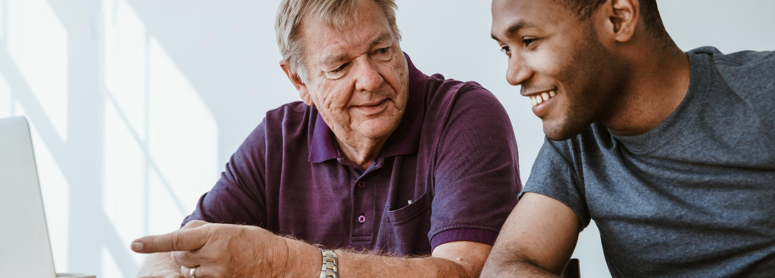
The Place
2.1. Imagine how the Club will run
The Club can be hosted anywhere: in person, online or hybrid. It is likely you will need to find an indoor space.
Think of places you know where meetings can happen. Should it be a private house? A public institution like a university classroom? A community space?
If you plan to use a community or private venue you will have to contact the venue in advance to book the room. For example, you could contact local associations dedicated to the support of migrants or elderly people.
You could also request a room from the town hall, community centres, or public libraries. Keep in mind these types of spaces require a formal request and it might take some time before you get a definite answer.
Also, it would be best if you can create a welcoming place where people feel comfortable. You could bring coffee/food or ask participants to bring and share. You can also decorate the space if you have time!
The People
Every club is different by definition. Nevertheless, the more diversity, the better.
During the recruitment process, these questions will need to be answered:
How many young, older and migrant people will there be?
How can we find these people?
What motivation might they have for joining in?
What skills or contributions can they bring?
What might their needs be?
Remember to consider your own commitment, time, and motivation towards the club and act accordingly.
8

Slide 9

2.2. Recruiting people
Tips to find members
1
Once you have a clear idea of how the Club should run, it’s time to identify stakeholders and spaces where you can find people whose skills, needs and motivations may fit the Club
Where to find them
2
  NGOs, Universities, Day Care Centres, Churches, Bars… even Social media channels, such as Instagram, Facebook, Reddit, LinkedIn or TikTok profiles
How to contact them
3
Be friendly explaining the idea
Do not overload with information and never push people
Remember your role as a facilitator
Create a simple leaflet to explain the aims
9

Slide 10
2.3. Setting up the group
1
Number of people
A minimum of six people is recommended to feel like the group can grow.
There is no maximum number for a group but we recommend you consider the limitations of the space available and the availability of facilitators before making sessions too big to be handled properly.
Take into account that some people might be more active in an online group chat than in real life sessions.
2
The ‘group chat’
We recommend you create a chat group in a service like Telegram or WhatsApp once you gather six committed people. Then add in more people as they are recruited.
If any member wants to add in more people, they should be able to do so by themselves. Grant them administrator status.
We recommend that you moderate the chat in collaboration with the members. You can get inspired in the “dos and don’ts” list in the “Rules” section of this Guide.
3
The space
The space can be provided by you or other members of the club
It can be beneficial to ask different members of the club to help provide, book or organise the space as this helps to foster a sense of ownership and commitment.
Do not hesitate to ask for spaces in institutions or organisations that have synergies with the project even if they are not actually involved with the club.
10

Slide 11

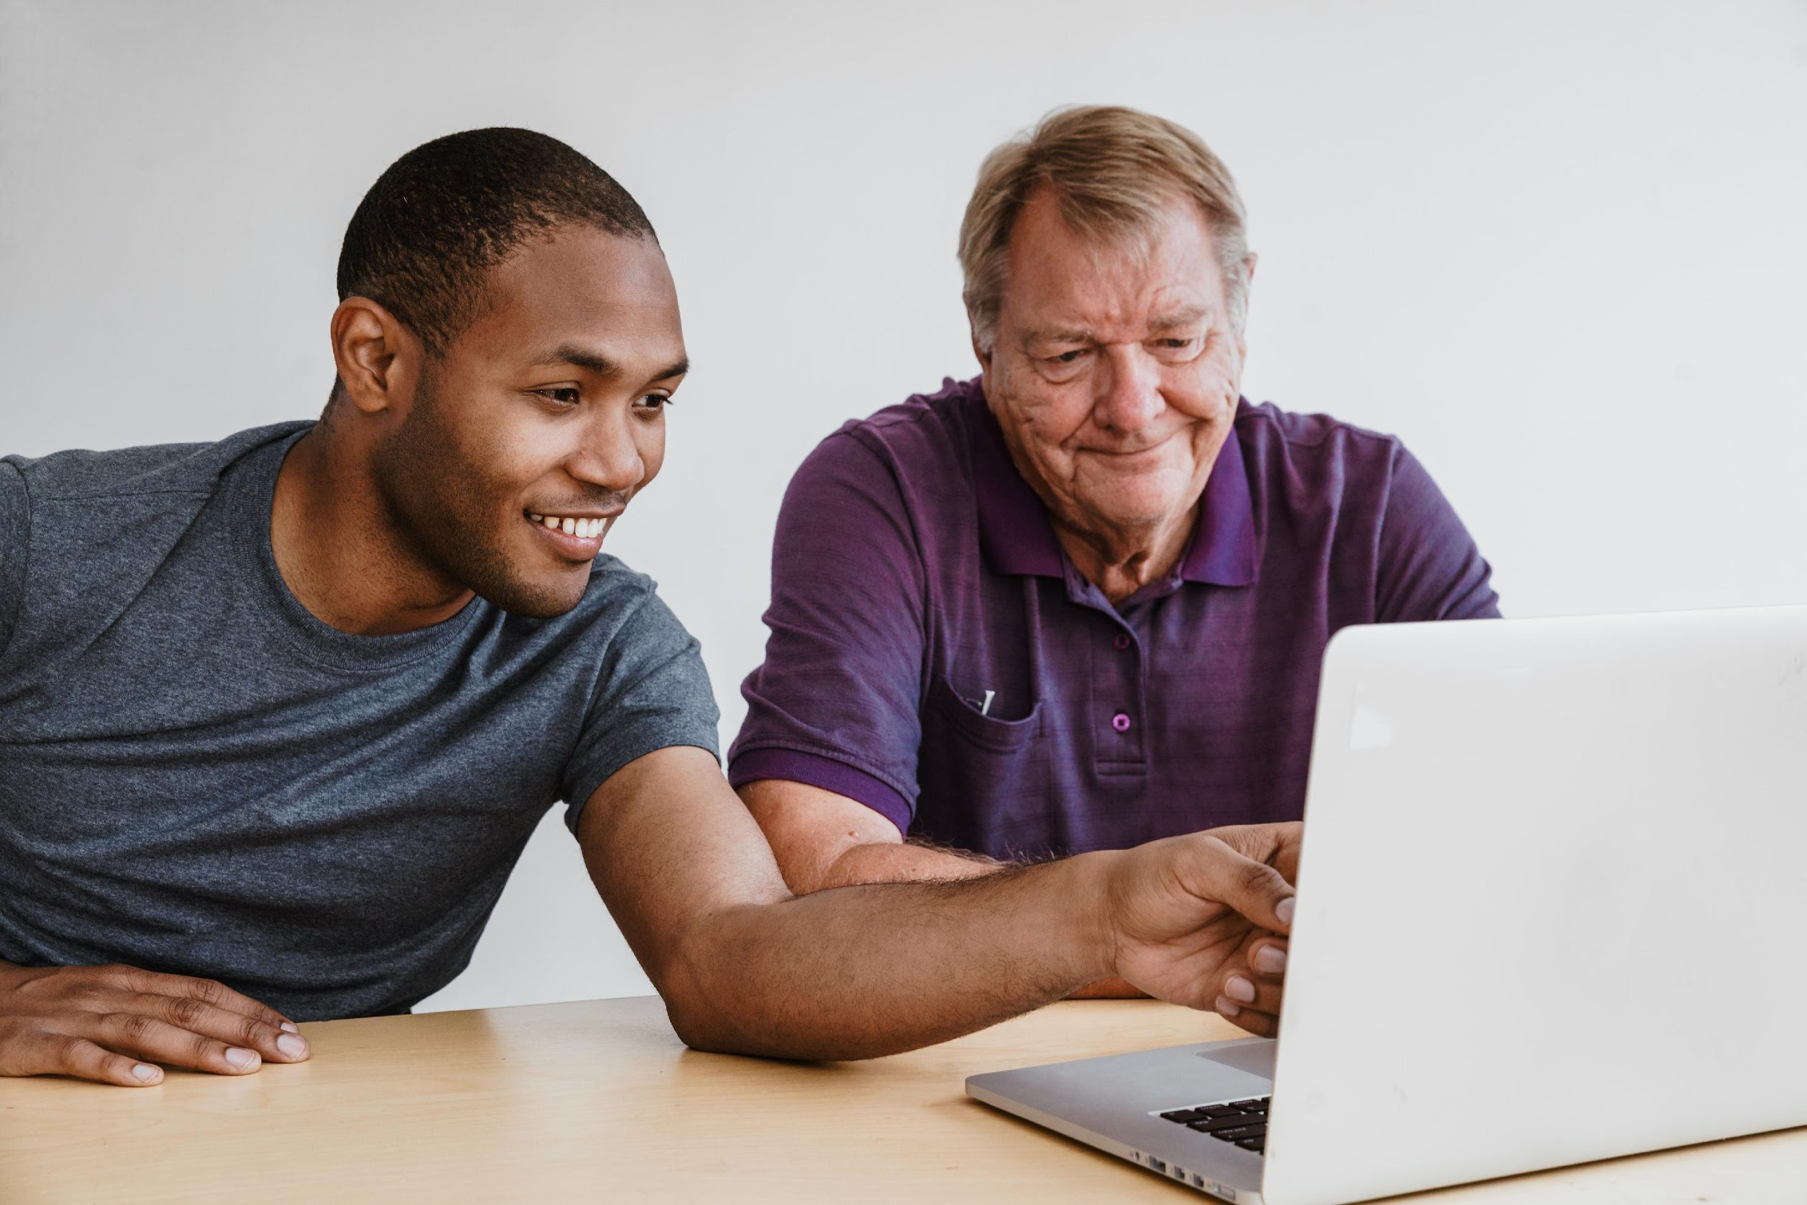
2.4. Checklist for the first meeting
There are a few milestones that need to be secured before starting to meet as a Community Club.
Also, these elements will remain essential to support the continuity of the Club and for it to become sustainable over time.
Recruit a minimum of six people
Remind the participants shortly before the meeting and ask them to confirm their attendance
Ensure you have an adequate place for the meeting (space, noise, temperature, health)
Make sure you have a good internet connection and digital infrastructure ready (for hybrid sessions)
Make sure every participant understands why they are attending the meeting (digital needs, expertise they can offer, etc.)
Make sure every participant has a general idea of what is going to happen during the session (see next section)
Prepare the space as explained in the following section
11

Slide 12

BELIEVE IN YOUR INFINITE POTENTIAL. YOUR ONLY LIMITATIONS ARE THOSE YOU SET UPON YOURSELF
Roy T. Bennett

Slide 13
03
RUNNING A COMMUNITY CLUB

Slide 14

3.1. Preparation
Make sure the space is comfortable and accessible. Check that there is seat for everyone. Also pay attention to the lighting, acoustics, etc.
Prepare water and other drinks if you consider it appropriate.
Depending on the situation and the people, you could arrange to have some food (for example, if the sessions coincide with lunchtime). Check for allergies beforehand!
Get to know the people that are coming a little bit before the meeting:
Understand how you should address each other (pronouns, etc.)
Understand any barriers they may experience (disabilities, etc.)
Identify ways to help everyone to feel welcome (for example, if someone needs help with language or needs to be introduced to feel comfortable)
There is no a maximum time for sessions to last, but it is necessary to spend one hour together to go through the steps that this guide proposes.
14

Slide 15
YOU ONLY KNOW YOURSELF WHEN YOU GO BEYOND YOUR LIMITS
Paulo Coelho
3.2. Icebreakers
There is no one way to do icebreakers. Depending on the people, you can try different approaches. However, the objective is always the same: bonding and trust. Here are some suggestions:
‘Get-to-know-you’ organised games:
Speed friending with fixed questions such as, What brought you here? Do you play videogames? What’s your favourite food? Etc.
Pros: people engage easily in these dynamics. It is also very quick.
Cons: Very artificial. It can make the group too dependent on the facilitator.
Please check the links below to see some examples of icebreaker games:
French
English
Spanish
Allow the group to have some time to chat before staring the meeting with/without coffee/sandwiches:
Pros: the befriending happens more naturally
Cons: time-consuming and can be awkward for some people (language impediments, young people, etc.)
One-to-one or group presentations:
Pros: everyone talks, and it is a familiar dynamic for most people
Cons: People tend to focus more on their presentation than in listening to others.
15

Slide 16
3.3. Rules
The group should write and sign its own rules collectively.
Firstly, the facilitator can propose some basic rules to get things started, such as:
Write your own list of ‘dos and don’ts’ help to create a safe environment – this ABC is provided only as an example of what you can propose.
After that, the members should discuss and propose new rules. To sum up, the rules will be written and agreed.
Periodically, the members should check the rules and change as necessary.
A
Address people as you would like them to do with you: respect how they identify themselves
Be patient with others, we all need our own time to process information
Contribute in turns, respecting other’s speaking time
B
C
16

Slide 17
KNOWLEDGE, ONCE GAINED, CASTS A LIGHT BEYOND ITS OWN IMMEDIATE BOUNDARIES
John Tyndall
DOS | DON’TS
✓ Use inclusive language | ✗ Tolerate sexist comments or behaviours
✓ Promote spaces where people feel heard | ✗ Permit certain members to capitalise interaction or dominate
✓ Promote constructive criticism | ✗ Allow personal criticism
✓ Understand cultural/ethnic diversity | ✗ Let prejudices or racist speech occur
✓ Recognise other’s generational knowledge | ✗ Take anything for granted based on age
✓ Promote respect of each other’s boundaries | ✗ Allow participants to override other people’s limits (unwanted physical contact, rude gestures, etc.)
✓ Make sure that every voice is heard | ✗ Let questions or opinions pass over without the group’s feedback
✓ Indicate the person kindly if there’s anything to correct | ✗ Publicly accuse someone if there is inappropriate behaviour
✓ Encourage a friendly peer-to-peer environment | ✗ Allow patronising ways of addressing each other (mansplaining, condescendence…)
✓ Promote digital skills as a group benefit rather than a personal asset | ✗ Allow bragging about digital skills
✓ Encourage calm discussion | ✗ Allow shouting under any circumstances
17

Slide 18
3.4. Putting the group to work
This is the core activity of these clubs - the space in which people explain the areas of their digital life where they want to improve and to find peers to help them.
This can take many forms, for example, some people may have trouble in dealing with Excel, while others want to learn digital design. This facilitated time is meant for everyone, shared equally.
Here are some ideas to help make this happen:
APPROACH 1
Before the session ask people to write down any aspect of digital skills that they have difficulties with, or something new they want to learn. Then they should share it with the club and find potential matches in other people.
Pros: People will choose topics that feel important to them. This dynamic creates commitment to the club in advance, saves time and brings focus.
Cons: It is possible that some people will not have anything prepared. Also, people might bring impossible topics.
APPROACH 2
Asl people to identify problems they think others might have with digital skills: this helps to identify problems without the need of thinking too much about themselves. It will naturally raise problems that others in the club may have.
Pros: Quick and easy for the participants to think. Everyone can join in.
Cons: Time-consuming and problems can be mentioned in very abstract terms.
After that, let the participants gather in groups based on their needs and what they can offer to each other. They should decide by themselves the best way to learn together. In that sense, you should not impose anything on them.
Make sure that the rules are followed in the smaller scale interactions too.
Check if there are any communication or language problems which you or other members can help to address.
Discourage groups becoming the isolated or stuck. Make sure there is a sense of unity in the club and allow people to move between groups.
18

Slide 19
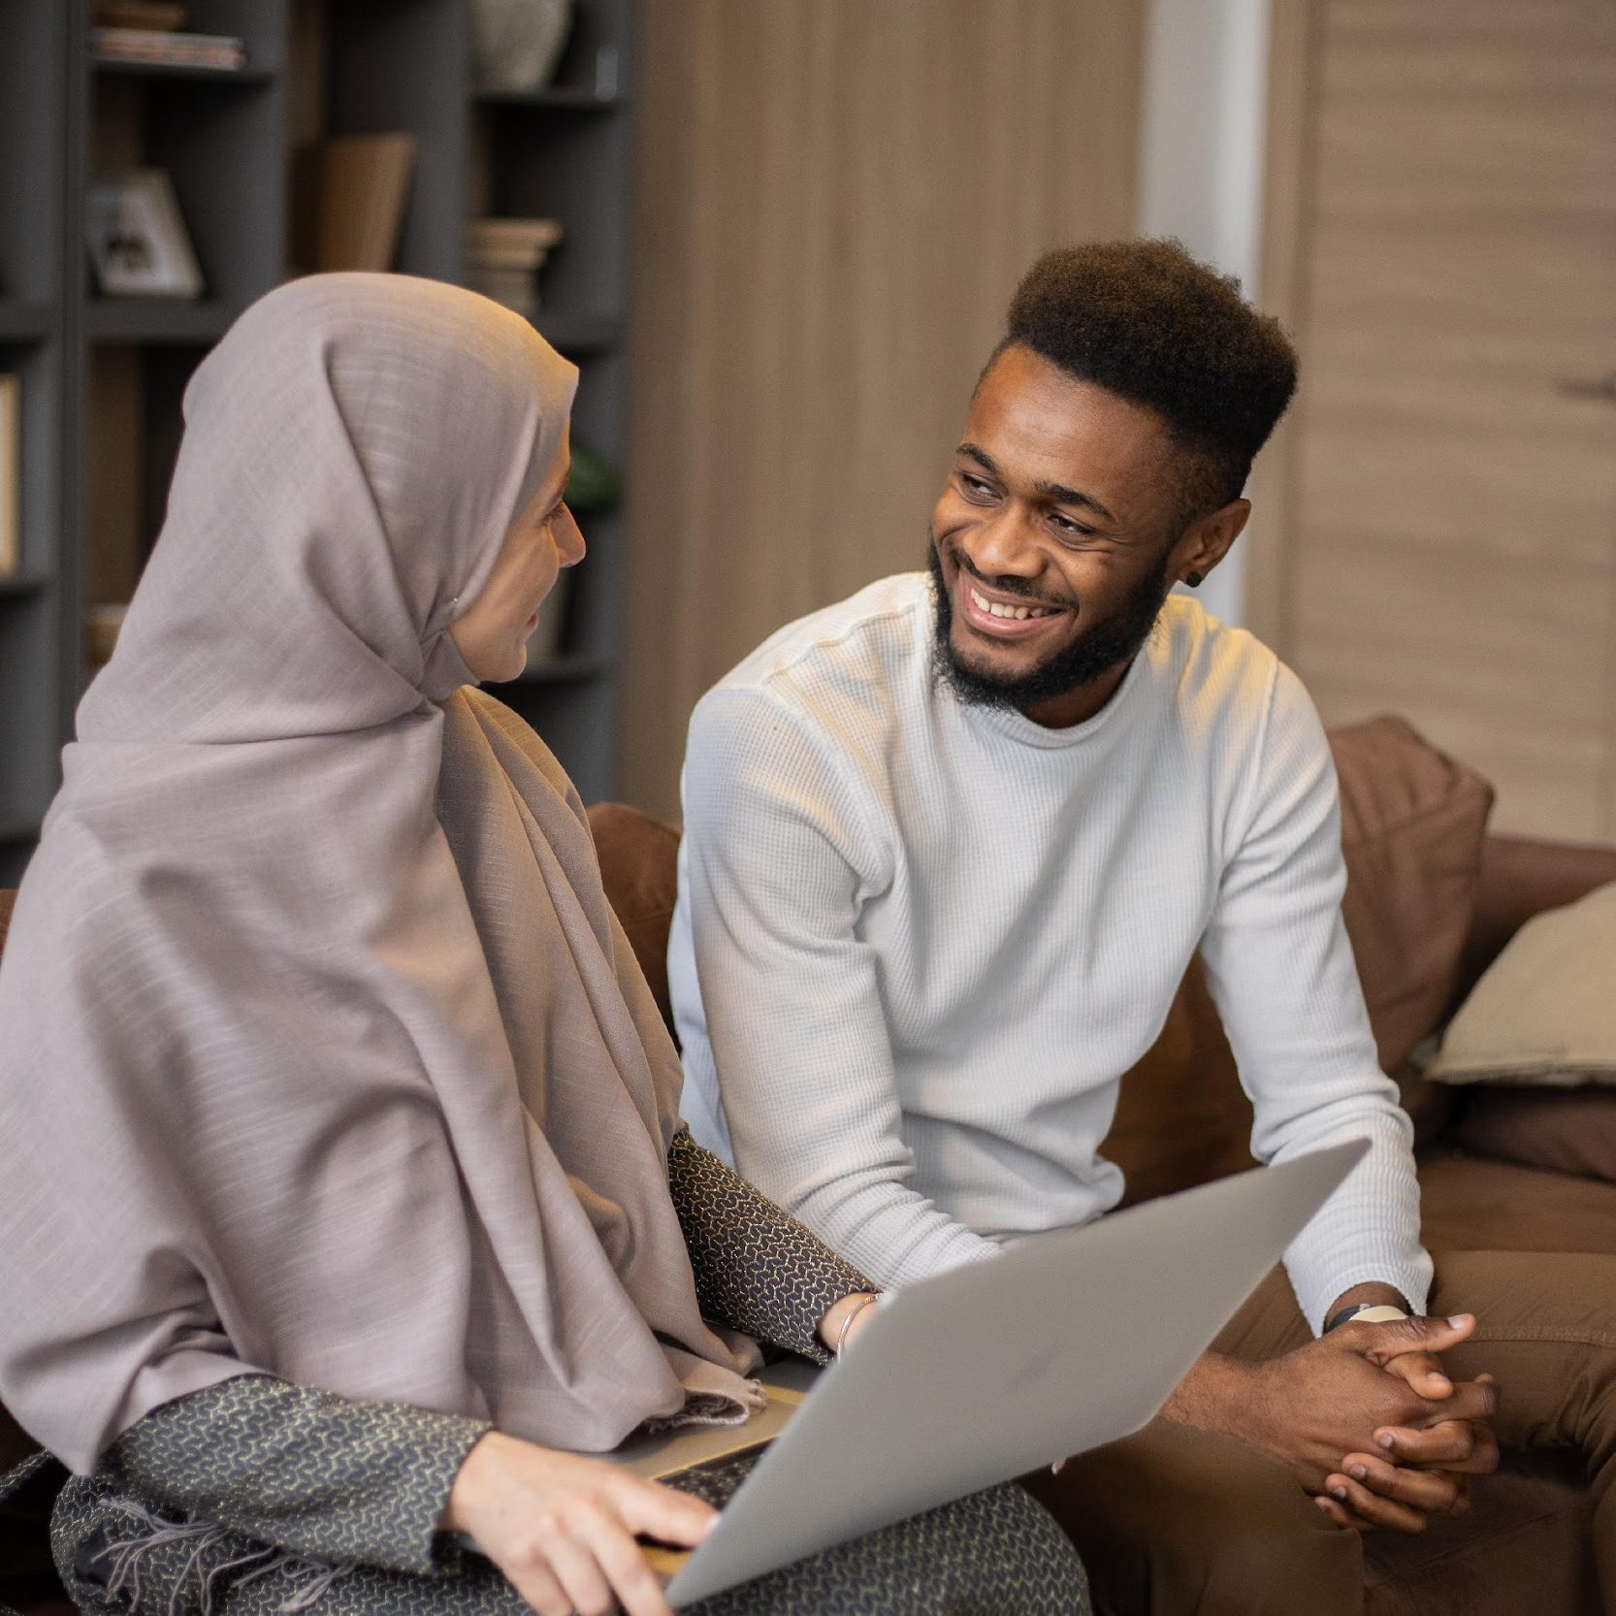
TELL ME AND I FORGET, TEACH ME AND I MAY REMEMBER, INVOLVE ME AND I LEARN
Benjamin Franklin

Slide 20
This can engage in terms of easily continuing to use the tools and meeting with other BESTIE Clubs.
There is also a BESTIE Facebook page that the club users can access.
The activities of the club should be engaging and practical, so the members have a reason to keep attending.
Make sure that participants have a reason to come back:
Learning new skills as a group – for example if two members decide to learn how to edit videos. This gives them a reason to come back to the sessions.
Ensuring people leave the sessions with a feeling of achievement. Tackle unresolved problems, etc.
Promoting the club as a space to make new friends and create alternative networks of care.
Allow conversations to take place and avoid imposing structured group dynamics over natural socialisation.
3.5. Sustaining the Club
The group needs an engagement channel, somewhere to stay united and engaged before and after the sessions. The club members should choose a platform that they are comfortable using.
If there is a lack of agreement or initiative, the facilitator is advised to suggest Telegram, since:
Club participants can maintain privacy, phone numbers are not shared.
For older people, it is intuitive. For younger people, it is trendy. For migrants, it is international.
It is easy to maintain as a spontaneous means of communication.
The app relies on a chatbot service, where frequent questions and answers are automatically replied.
20

Slide 21

3.6. Dissemination
It would be positive to communicate BESTIE’s potential achievements beyond the club. There are two ways to do this:
Online: Through social media tagging the BESTIE profile on Facebook and / or LinkedIn. You can also do it via instant applications such as Telegram or WhatsApp.
Offline: Word of mouth or through advertising on public notice boards (universities, older people’s day-care centres, neighbours and migrants’ associations, workspaces, etc.)
LEAFLET SAMPLE
21

Slide 22
FOR THE THINGS WE HAVE TO LEARN BEFORE WE CAN DO THEM, WE LEARN BY DOING THEM
Aristotle
3.7. Evaluation
You should carry out an evaluation and seek feedback after every session.
Evaluation of digital competences and achievements
Take the following table as an example; leave a blank space if there is no progress.
The objective column is about the broad objectives the member has (these can change). The progress column applies to what was done during the session.
Evaluation of meeting dynamics
To encourage the participants to attend future meetings please evaluate the tools and formats used in each session.
Here is an example of how to do this:
Create a table with the things that everyone felt comfortable with and the things that they didn’t like or enjoy. Everyone can participate and share their feelings during the session.
Pros: It is a good way to identify the less effective activities, to decide not to repeat them.
Cons: Everyone might not share which activities they didn’t enjoy.
Member | Objective | Progress (if applicable)
Eugenia | Post photos for her socials | Edited a photo today with Renata’s help
Dan Ye | Create a good LinkedIn Profile | Translated his professional experience with Gregory’s help
Gregory | Access public administration to claim his tax report
Omnia | Programming in Python | She was shown some interesting tutorials by Dan Ye
22

Slide 23
04
DIGITAL TOOLS FOR CARRYING OUT ACTIVITIES

Slide 24
1
VIDEO PLATFORMS
For video calls and hybrid sessions you can explore: MS Teams, Google Meets, Jitsy, Zoom, Skype, WhatsApp
RECRUITING MEMBERS
2
Find people to join social digital initiatives like: Empodera.org
ORGANISATIONAL TOOLS
3
To schedule meetings that suit everyone, you can try using tools like
Doodle. It is intuitive and it is not compulsory to sign in.
Explore the Digital Toolkit
by BESTIE for other tools!
24

Slide 25

ANYONE WHO STOPS LEARNING IS OLD, WHETHER AT TWENTY OR EIGHTY. ANYONE WHO KEEPS LEARNING STAYS YOUNG
Henry Ford
Karim Rashid

Slide 26


CONTACT US!
Website Here
BESTIE Facebook Profile!
www. bestieproject.eu
follow our journey

